Slide 1
Welcome!
Welcome to this Contact Webinar
If there is a technical hitch, please do bear with us
Those of you joining by pc, laptop, tablet or smart phone should now be able to see this introduction slide

Slide 2
Timings and Questions
As there are so many attendees you will all remain ‘muted’ throughout
To ask a question of the presenter, please use the question icon on your GoToWebinar tool bar on your screen
This will allow you to type your question in to the text box and submit this to the Webinar administrator
I will select as many relevant questions to answer as time allows, if similar questions are received I will condense these where possible

Slide 3
Q & A
Further relevant questions, not covered in the time allowed, will be answered and posted on the Contact website along with the recording of this Webinar, details of which will be circulated next week
At the end of the Webinar a short questionnaire will launch, please take the time to complete this as this will assist with future online training events

Slide 4
Transforming Care Accelerator Site Cumbria and the North East Region ‘Schools, Families & Supporting Children & Young People with Autism’

Slide 5
Core Principles – getting it right from the start
Listen and Respond
Early Intervention
Joining things up
Building resilience

Slide 6
Accelerator Project – what does it involve?
Project 1
Working with 13 mainstream schools to improve knowledge and understanding of how to support Autistic Students and their families.
Linking Parent Carer Forums with these schools so that they can create local support and information groups for parent carers of children with special educational needs and disabilities, including Autism
Offering ‘All About Me’ training to some young people with Autism who attend these schools – to help them explore and understand how Autism impacts their lives, both positively and negatively

Slide 7
Accelerator Project - What does it involve continued…
Project 2
Established Children and Young People’s Peer Network – bring together practitioners from education, health and social care teams and parent carers to share their experience of the system and identify barriers and opportunities

Slide 8
What were we aiming to achieve?
Project 1
To create a supportive school environment for young people with Autism
To promote a person centred approach to working with Autistic students in mainstream school – so that teaching staff understand the challenges faced by individual students and are able to put reasonable adjustments in place where needed
To enable autistic young people to understand their own strengths and challenges – increasing confidence and self awareness
To improve working relationships between families and the schools, by the creation of school based support groups offering peer to peer support and reducing isolation

Slide 9
What were we aiming to achieve continue…….
Project 2
Increasing practitioners understanding of how the wider system works, beyond their own work area
Exploring how different work areas impact or support each other
Identify gaps and barriers in the system
Share and develop good practice
Developing a more joined up and co-ordinated approach to providing support

Slide 10
Accelerator project – Activity and Achievements?
Coproduction;
Understanding what good would look like
Equal partnership - Steering group including parent carer representation, Director of Children’s Service and LA Senior management and Senior Health leads
Forum representatives involved in all activity – from the beginning
Work informed by the voice of young people – Take Time to Allow Time work
Learnt about each other – our language and way of working
Building new and strong relationships

Slide 11
Activity and Achievements
Project 1 – Creating an Autism Positive Environment
Secured sign up from senior management at mainstream schools and identified lead contacts
Worked with schools and Forums to develop a learning and development timetable;
Understanding the impact of sensory processing on the child and family
Self-awareness and Positive Behavioural Support
Effective communication and its impact on setting boundaries and reducing anxieties.
Reasonable adjustments & equality – working with families on managing inclusivity in the classroom
Engaging parents and carers in effective person centred planning

Slide 12
Activity and Achievements…….
Forums to develop baseline survey about family / school relationship
Forums introduced to schools and initial parent carer support programme developed
‘Inclusion and Equality’ Conference
‘All About Me’ Course started
Worked with young people to create materials to promote Annual Health checks
Provided clinical advice sessions for schools
Held focus groups with Autistic young people to inform production of Autism and School Film

Slide 13
Activity and Achievements……..
Project 2 – Creating One System
Launched Children and Young People’s Peer Network and held 3 further ‘local’ network sessions.
Shared information on Annual Health Checks and ‘Local Offer’ at all sessions – discussion activities resulting in;
Report on improving uptake of Annual Health Checks
Developed wider understanding of the SEND Local Offer and how services should support its development
Discussion sessions on; the journey of children and young people with learning disabilities and/or Autism and what data do we need and why? Feedback will inform development of Dynamic Support Registers in the Region

Slide 14
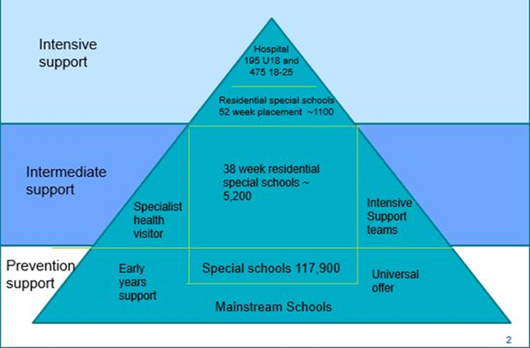
Journey of CYP with Learning Disabilities and or Autism - What have we learnt?
“Too Many Missed Opportunities”
Small issues are not addressed and become major issues for CYP
CYP can’t access the support needed due not meeting thresholds / criteria
Lots of assessments and meetings but little action / change
Need to invest at the bottom of the triangle

Slide 15
Knowing our Children and Young People – What have we learnt?
“Lots of people knew that my daughter wasn’t coping but nobody did anything”
We collect lots of data on children and young people but it isn’t telling us what we need
There is no consistent approach to data collection – who do we need to know about and when?
Data needs to lead to inform action – currently it often doesn’t

Slide 16
Making a difference?
Forums are creating new links in their communities and gaining new members
Forums are increasing their skills base and contacts in terms of working with the health sector
Schools are reporting a better understanding of the wider system “I now know where to sign post families too”
Schools are starting to use person centred tools such as one page profiles
Schools reviewing their behaviour policies
Increased peer support and information for parent carers
Areas outside the project are showing an interest in this approach
We are thinking differently and working together

Slide 17
Making a Difference
“As a forum, we have found that the Transforming Care project has developed and strengthened our relationships with schools. Other schools have been eager to participate in the project as a result of the positive impact this program has had. We have seen an increase in membership directly resulting from the schools promoting our service and parents have attended our events outside of the project. The training we have received and the opportunity to meet with professionals across the whole of the region has increased our knowledge and broadened our links with services.
Our biggest success as a result of this project is that we now have a group of parents willing to take forward a school parent carer forum, which we will support to develop their skills in working with the school to improve the setting and the experience that their children have.”

Slide 18
Autism and School Film
‘Take Time to Allow Time’
https://vimeo.com/319826408?fbclid=IwAR2QyXbcTW2dOz_Pp47l8MKOxPmZ87xs5KJ-UbYMsXi5GJ7wfD5-s4n2Imk

Slide 19
What Next?
The CYP Peer Network is continuing and is being developed further, so that system wide discussions and activity can continue to be promoted
Hoping to extend the school project to the north of the region and to further embed activity in the south.
Sharing and promoting learning through local and national networks
Linking activity and learning to the implementation of the NHS England Long Term Plan commitments

Slide 20
Thank You
If you would like to know more please get in touch
Sarah Thomas
s.e.t@btinternet.com
Contact Associate – Participation & Co-production
Julie Bates
juliebates2@nhs.net
NHS ENGLAND & NHS IMPROVEMENT

Slide 21
Q & A

Slide 22
Thank You!
Thank you for attending with us today
A short questionnaire will launch at the end of this webinar, please take the time to complete this it will help us plan future online training events including other topics you would like to see
The recording of this Webinar, presentation and questions will be on the parent participation Resources page of Contacts’ website next week – an email confirming this will be sent to you once this is available

