Slide 1
SEND Support – what does it mean for
your children?
A Contact webinar in partnership with nasen and presented by Alex Grady,
Education Development Officer at nasen
26th June 2019

Slide 2
Welcome to this Contact webinar.
If there is a technical hitch, please do bear with us.
Those of you joining by pc, laptop, tablet or smart phone should now be able to see this introduction slide.

Slide 3
Timings and Questions
Please use the question icon on your GoToWebinar tool bar on your screen, this will allow you to type your question in to the text box and submit this to the Webinar administrator

Slide 4
Key questions we will address:
Consider
www.nasen.org.uk
What is SEND legislation and what does it mean for your children?
How do schools identify and support pupils with SEND?
How should parents be involved in this process?
Notes:
Start by saying what nasen is and my role in it.
Then go through questions

Slide 5
Do you have questions?
Why is HQT important?
Please feel free to put your questions at any point during the webinar.
I will aim to answer as many as I can, at the end of the webinar.
I won’t be able to answer specific questions about individual children and young people, due to not having the background information, but will do my best to answer more general questions.

Slide 6
SEND legislation
The Equality Act, 2010
Requirements for schools regarding pupils with disabilities:
Discrimination, harassment and victimisation are outlawed
Both current and prospective pupils are covered i.e. including admissions
The governing body is responsible for implementation
Requirement to make ‘reasonable adjustments’
Requirement to make ‘anticipatory’ adjustments
‘Positive actions’ are permissible for pupils with disabilities
Notes:
The Equality Act provides a legal framework to protect the rights of individuals and advance equality of opportunity for all.
Disability in one of the protected characteristics, and covers a wider range than people sometimes realise. For example, ADHD, dyslexia and autism are all ‘disabilities’ under the Equality Act
Go through requirements for schools. Mention SEN governor

Slide 7
SEND legislation
The Children and Families Act, 2014
Core principles:
Local authorities must pay particular attention to:
• the views, wishes and feelings of children and their parents, and young people
• the importance of them participating as fully as possible in decision-making and providing the information and support to enable them to do so
• supporting children and young people’s development and helping them to achieve the best possible educational and other outcomes
Notes:
This legislation, on which the SEND code of Practice is based, places the child squarely at the centre of all decision making at every level.
Go through core principles CLICK

Slide 8
SEND legislation
The SEND Code of Practice, 2015
Core principles:
From birth to 25 years, preparing for adulthood from the earliest days
Person-centred practice
Early and effective identification
Appropriate support and provision to meet needs (through a graduated approach)
High aspirations for outcomes for everyone
‘Mental health’ has replaced ‘behaviour’ as a category of need i.e. looking beyond presentation to causation
Notes:
This is statutory guidance that all state-funded schools MUST have regard to, as must LAs, special schools, FE and sixth form colleges, PRUs, EY providers that receive funded places, NHS, CCGs

Slide 9
SEND legislation
The definition of SEN under the SEND Code of Practice, 2015:
‘A child or young person has SEN if they have a learning difficulty or disability which calls for special educational provision to be made for him or her.
A child of compulsory school age or a young person has a learning difficulty or disability if he or she:
Has a significantly greater difficulty in learning that the majority of others of the same age, or
Has a disability which prevents or hinders him or her from making use of facilities of a kind generally provided for others of the same age in mainstream schools or mainstream post-16 institutions.’

Slide 10
What is the ‘SENCO’?
Why is HQT important?
‘SENCO’ stands for ‘Special Educational Needs Coordinator’
All mainstream schools must appoint a qualified teacher as SENCO
Most SENCOs will have the ‘National Award for SENCO’, a specialist post-graduate qualification
They may be supported by an ‘assistant SENCO’, sometimes a teaching assistant or another teacher
It is possible for the headteacher to be the SENCO, but this is not generally recommended
Many SENCOs have other responsibilities, such as class teaching; for most, the role of SENCO is part-time

Slide 11
The role of the SENCO
Why is HQT important?
Key responsibilities include:
Over-seeing the day-to-day operation of the school’s SEN policy
Coordinating provision for children with SEN
Advising on the graduated approach to providing SEN support
Advising on the deployment of the school’s resources to meet needs
Liaising with parents of pupils with SEN
Liaising with external agencies, such as educational psychologists, the local authority etc
Liaising to ensure a smooth transition to the next stage of education
Ensuring that all records of SEN are up to date
Working with the head and governors to ensure the school meets its responsibilities under the Equality Act
But every teacher is a teacher of SEND – every teacher has responsibility

Slide 12
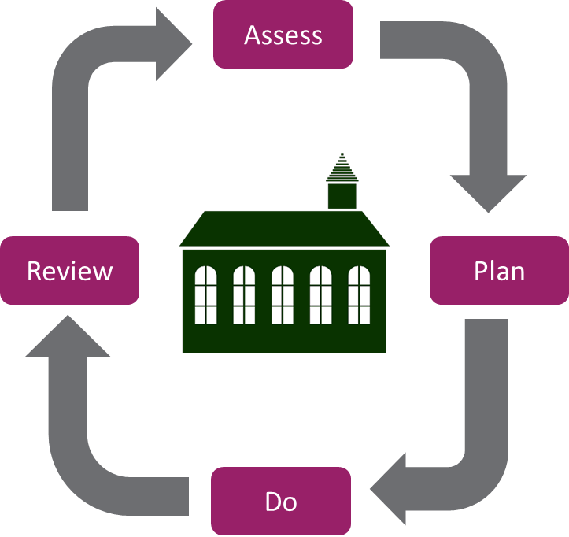
How do schools identify and support pupils with SEND?
Why is HQT important?
Emphasis on early identification
Importance of high quality teaching for all
Regular assessments are made anyway…..
Regular assessments feed into a ‘graduated approach’ to identifying and meeting SEND
Notes:
GA
SEN register

Slide 13
How do schools identify and support pupils with SEND?
Why is HQT important?
Schools need to consider evidence that a pupil may have a disability under the Equality Act and, if so, what reasonable adjustments might need to be made for them. Pupils who are making less than expected progress given their age and individual circumstances may be identified as having SEN.
This can be characterised by progress which:
Is significantly slower than that of their peers starting from the same baseline
Fails to match or better the child’s previous rate of progress
Fails to close the attainment gap between the child and their peers
Widens the attainment gap
It can include progress in areas other than attainment e.g. their wider development or social needs.

Slide 14
How do schools identify and support pupils with SEND?
Why is HQT important?
There are many possible examples of reasonable adjustments, including:
Allowing a child with sensory needs to wear jogging bottoms instead of school trousers
Seating a child with a hearing impairment at the front facing the teacher
Allowing a child with autism to enter and exit the classroom before everyone else to avoid crowded corridors and physical contact
Enabling a child with social interaction difficulties to work on their own if preferred, rather than in a pair
Providing a word bank for a child with dyslexia
Providing an alternative space for break times for a child who with social anxiety
Providing ramps for a child using a walking frame
….the list is probably endless and each adjustment should take account of the individual child’s needs.

Slide 15
How do schools identify and support pupils with SEND?
Why is HQT important?
High-quality teaching
Intervention?
Information from parents should support and inform this process
Parents must be informed if their child is identified as having SEN
Work with the SENCO to assess whether a pupil has SEN
Notes:
The first and most important response to any pupil who may have SEN is always CLICK high-quality teaching, targeted at any areas of weakness. This will be carried out by the class or subject teacher, sometimes supported by a teaching assistant if they have access to one.
If the pupil continues to make less than expected progress, the class or subject teacher may put an CLICK intervention in place, for example, additional phonics teaching. This does not necessarily mean this pupil has SEN.
If progress is still a concern despite high quality targeted teaching and possibly intervention, the class or subject teacher should be talking to the SENCO to assess whether a pupil may have SEN
Or course, CLICK information from parents should support and inform this process, and CLICK parent must be informed if their child is identified as having SEN

Slide 16
How do schools identify and support pupils with SEND?
Why is HQT important?
‘SEN register’
‘SEN Support’
Slow progress and low attainment do not necessarily mean that a child has SEN
Attainment in line with chronological age does not mean that there is NOT a learning difficulty
EAL is not a SEN

Slide 17
How do schools identify and support pupils with SEND?
Why is HQT important?
The four broad areas of need
Pupils’ primary needs are identified in one of these areas:
Communication and interaction
Cognition and learning
Social, emotional and mental health difficulties
Sensory and/or physical needs
Notes:
May have needs across one or more areas
‘the purpose of identification is to work out what action the schools needs to take, not to fit a pupil into a category’

Slide 18
Special educational provision
Why is HQT important?
High quality teaching, differentiated for individual pupils, is the first step in responding to pupils who have or who may have SEN.
At ‘SEN Support’, the teacher and SENCO will work together to consider all the information about a pupil to decide what provision is required. This should include a discussion with the pupil (when appropriate) and their parents.
Schools should tell parents about the LA’s ‘SEND Information, Advice and Support Service’ (SENDIASS).
The desired outcomes for a child should be considered.
A date to review progress should always be set (usually termly, but at least yearly).

Slide 19
Special educational provision
Why is HQT important?
When a pupil is identified as having SEN, schools should take action to remove barriers to learning and put effective educational provision in place. This process should follow the graduated approach (assess, plan, do, review).
Parents should be aware of any planned support and interventions, and where appropriate, plans should seek parental involvement to reinforce or contribute to progress at home.
The class or subject teacher remains responsible for working with the child on a daily basis.

Slide 20
Special educational provision
Why is HQT important?
Sometimes, it may be appropriate to offer some one-to-one support for a child with SEN.
But this should be carefully planned so that the child is able to continue to develop independence in learning and self-help skills.
Too much one-to-one support can have a negative impact on outcomes for some children (see DISS Report, 2009: http://maximisingtas.co.uk/research/the-diss-project.php)
Where additional TA or teaching support is given, it should fit closely with class teaching and the class or subject teacher retains responsibility for progress, with the support of the SENCO.

Slide 21
Involving external agencies
Why is HQT important?
The school may consider that they need to seek advice and support from specialists external to the school, if progress is still not as expected.
Specialists can be involved at any point, and parents must always be involved in any decision to involve specialists.
Specialists may include:
Educational psychologists
Speech and language therapists
Specialist teachers e.g. for dyslexia, hearing impairment, physical disability etc
Special school staff
Occupational therapists
etc
Notes:
It can be challenging for schools to be able to access some specialists, despite their best efforts.
If a child needs to see a medical professional, such as a paediatrician, parents will need to go via their GP

Slide 22
Education, Health and Care Plans
Why is HQT important?
It may be that, after following the advice and guidance from within school and from specialists, a child is still not making expected progress. It may then be considered that an application for an Education, Health and Care Needs Assessment is made.
It is usually appropriate to complete more than one cycle of assess, plan, do, review before making an application for an Education, Health and Care Needs Assessment. The local authority will ask to see evidence of the action taken by the school as part of SEN Support. If an EHCP Needs Assessment is carried out, it may result in an Education, Health and Care Plan being issued. An EHCP is usually required to access a special school placement.
We are not going to go into detail in this webinar about Education, Health and Care Plans, as we are focusing on SEN Support.

Slide 23
The School’s SEN Information Report
Why is HQT important?
Every school has to publish on their website an ‘SEN Information Report’.
This must include information about how SEN are identified in the school, how parents and pupils are consulted, what provision is made for SEN in the school and who the SENCO is.
It should be easily accessible to parents and young people.
It should also include information on how to access the Local Authority’s ‘Local Offer’.

Slide 24
The Local Offer
Why is HQT important?
Every Local Authority MUST publish a ‘Local Offer’ on their website.
This should provide information on provision for SEND within a local area, including mainstream and special schools, independent schools, services, groups etc which are relevant to children and young people with SEND.
They should be co-produced with parents and young people, and be accessible and easy to use.
They vary a great deal in quality, but if you haven’t looked at yours, you should do so.

Slide 25
How is SEND funded?
Why is HQT important?
Per-pupil weighting:
Varies from one LA to another.
Pays for everything a school normally provides
‘Notional’ SEN budget
£6,000 per pupil.
Not ring-fenced
‘High Needs’ funding.
Held centrally by the LA.
Schools usually apply for it.

Slide 26
How might SEND funding be spent?
Why is HQT important?
Both the per-pupil weighting and the SEND notional budget may be spent at the school sees fit, but they need to be able to demonstrate that a pupil’s needs are being met.
Often, this funding is spent on teaching assistants or extra teacher time, but it is possible, and sometimes more effective, to be more creative. Examples include:
Speech and language therapy
Other forms of therapy e.g. art therapy, occupational therapy etc
Resources such as ICT programmes, hardware, teaching materials, books, games etc
Mental health support, counsellors etc
Sensory equipment, possibly a sensory room
Training for staff in SEND

Slide 27
What can you do if you are not happy?
Why is HQT important?
Always go to the class/subject teacher or form tutor in the first instance, they know your child the best and work with them daily or regularly. This is likely to be all that is needed to resolve your concerns. Don’t wait til parents’ evening! Make an appointment.
If you are still concerned and your child is already on ‘SEN Support’ you could then go to the SENCO. Hopefully you and the SENCO will be able to work together with class/subject teachers to resolve any issues. If you think they should be on SEN Support and they are not, go through the class teacher/form tutor.
If you are still dissatisfied, go to the Headteacher, and finally, the Governors, particularly the SEN Governor.
If your issue remains unresolved, go to the LA and/or seek further advice and support.

Slide 28
Where can parents go for more advice and support?
Why is HQT important?
Independent Provider of Special Education Advice
www.ipsea.org.uk
SENDIASS
SEND Independent information and Advice Service: each LA has one – search online for your LA
Notes:
SENDIASS
IPSEA
Possible to appeal against decisions and go to mediation and ultimately tribunal - always look for legal advice from one of these organisations

Slide 29
In summary…
Why is HQT important?
The SEND Code of Practice is the statutory guidance to which schools and local authorities must have regard
High quality teaching is the most important factor for everyone, including children with SEND – always speak with the class or subject teacher and maintain open communications
If your child is identified with SEN, get to know the SENCO – they should be able to offer you advice and support
Find out how your child is being supported, and make sure that this is regularly reviewed
Go to the headteacher, governors or other sources of advice if you are dissatisfied

Slide 30
Question time
Why is HQT important?
If you haven’t already done so, now is your opportunity to send in a question.
I will aim to answer as many as I can in the time we have available.
I won’t be able to answer specific questions about individual children and young people, due to not having the background information, but will do my best to answer more general questions.

Slide 31
Thank you!
Thank you for attending with us today.
A short questionnaire will launch at the end of this webinar.
Please take the time to complete this as it will help us plan future events.
The recording of this webinar and presentation will be available on Contact’s website in the next two weeks. Look out for news about this on our homepage and social media networks.

